Slide 1
Test automation For architecture-based application project (using Java EE Web framework)

Slide 2
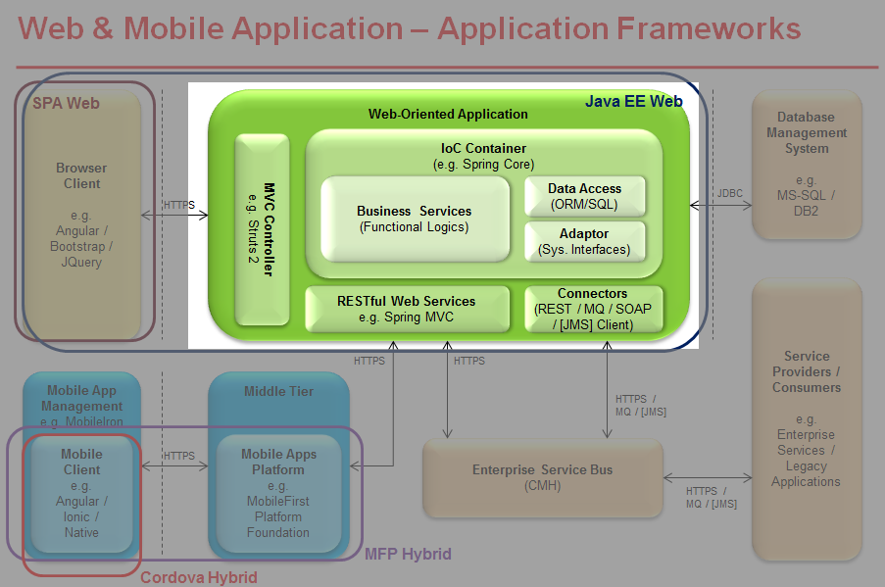
Background
An in-house Java EE web framework is in place and used by a few projects of the bank e.g. (S360 , IBK Revamp)

Slide 3
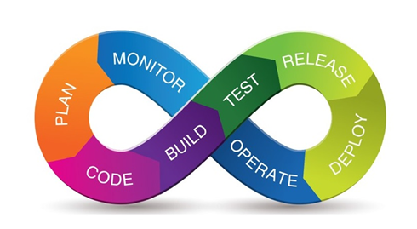
Background
Goal
To automate and streamline the test process
To enhance software quality
To enhance productivity of developers and testers
Proof of Concept was done already to verify technical feasibility

Slide 4
Background
Entry criteria (To be confirmed)
Architecture core modules (All XAA modules and Biz templates)
Major Application Changes / Application Revamp Exercises of Class A system using the in-house Java EE web framework

Slide 5
Background
Why test automation is important for architecture components ?
- Architecture components are reused by multiple projects so sufficient testing is crucial to increase software quality
- Easier to run all unit tests and system tests (regression) when there are changes such as
Apply bug fixes
Change library dependencies (due to deprecate or upgrade)
Add new functionalities
Apply OS/software patch which will affect architecture based project
Test on new OS/software platform

Slide 6
Scope
Types of Tests
Types of tests | Scope | Execution Frequency | Execution speed | Stability (More stable when application change)
Unit test | To validate a single functionality is operating as expected in isolation within the same module or program | High | Fast | High
System test | To validate all the features within the same system are operating as expected in isolation (with mocking if required) | Medium | Slow | Medium
Integration test | To validate the behavior of the whole system when integrating with other external systems System test without mocking | Low | Very Slow | Low
UI (User Interface) test | Simulate real user interacting with the application | Low | Very Slow | Low

Slide 7
Scope
UI Test (Automated test in a full deployed application using real database)
System Integration Test (In-memory database, in container , real interface)
View Client
Java EE Web Application
External
System
System Test (In-memory database , in container , mock interface)
MVC Controller (Struts 2)
Runtime Container
(Spring core)
Adaptor
System Interface
Core
Services
Functional Logic
Data Access
ORM / SQL
CMH (MQ / HTTPS)
Web Service Client
Browser Client
Connectors
(REST / MQ /
SOAP / JMS)
Web Services
Spring MVC

Slide 8
Test Architecture
(System test or Unit test with run-time container but without server startup)
(System test or the UI test with server startup and deployment)
BizSystemTestLocal
BizSystemTestRemote
XAATesting
Common API (e.g. Read test data , generate test report)

Slide 9
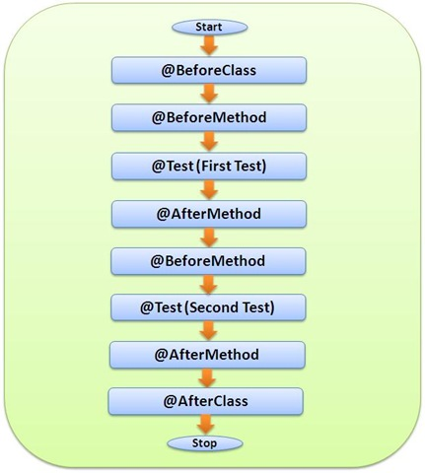
Test Architecture
TestNG annotation

Slide 10
Test Architecture
Parameterized Test using the TestNG dataprovider
TestNG
(Test runner)
Your test program
@Test( dataProvider = “excel" , groups="Demo",description="XML Demo")
public void yourTest( SelectItem[] cols, Object[] data) {
// use data array as each row of excel data
// do testing
}
@DataProvider( name = "excel" )
public Object[][] gatherExcelData()
{
File xlsFile = new File("test-data/DemoMetaModel01-Test.xls");
return XAATestingData.getExcelData( xlsFile, "DP" );
}
Test data

Slide 11
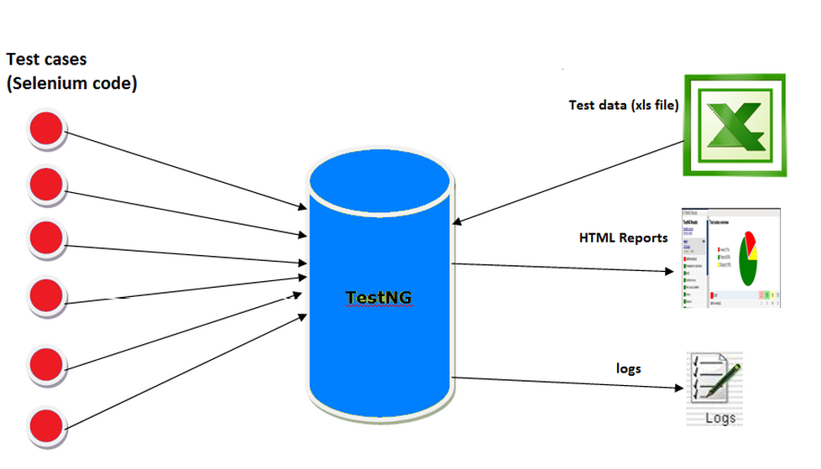
Test Architecture
TestNG drive Selenium test

Slide 12
Spring + Struts system test
Test automation feasible for testing Spring + Struts 2 actions with Strut 2 JUnit plugin (StrutsSpringJUnit4TestCase)
public class Test_SYS_BizWebApp_Actions_001 extends StrutsSpringJUnit4TestCase<XaaAction>
…
RequestContextHolder.setRequestAttributes(new ServletRequestAttributes(request));
SessionMap<String, Object> sessionMap = new SessionMap<String, Object>(request);
// setup request parameters
request.setParameter("userId", "TCTR630");
request.setParameter("password", “xxxxxxxxxxx");
// setup action proxy for the struts action
ActionProxy proxy1 = this.getActionProxy("/xsa/login");
// set session object for the action proxy
proxy1.getInvocation().getInvocationContext().setSession(sessionMap);
SysUserAction action1 = (SysUserAction) proxy1.getAction();
String result1 = proxy1.execute();
// assert if login is successful
Assert.assertEquals(result1, XaaAction.HOME);

Slide 13
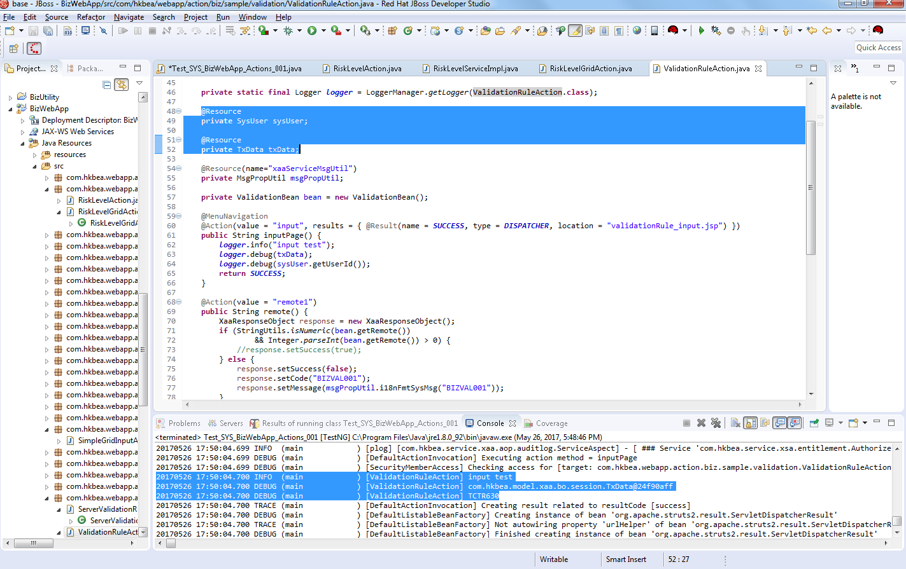
Spring + Struts system test

Slide 14
Test Coverage
Test coverage is a percentage measured to describe the degree to which the source code of an application is executed for all the automated tests
A test run which has high code coverage when more application source code are executed during the test run, which suggests it can better detect software bugs
Provide a metric to measure the confidence of test 50% baseline test coverage (industry guideline) 70% - 80% optimal test coverage (industry guideline)

Slide 15
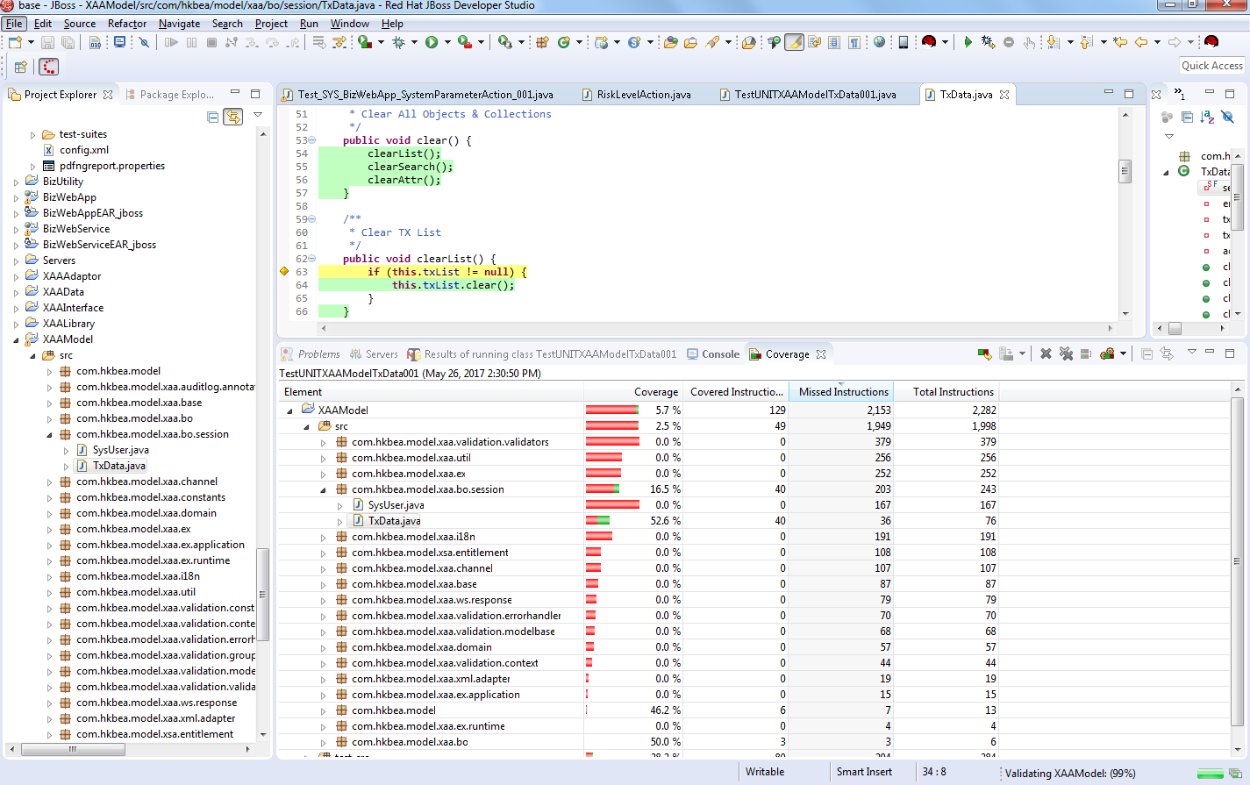
Test Coverage

Slide 16
Test guideline
Standards and best practices for easier maintenance of automated tests
Standardize test artifacts locations (test source code , test data , test suites , screen dump)
Test coding standard
Test class name
Test method name
Test method annotation
Test program logic
Test data parameterization
Test quality
Test for input and output (not depends on implementation detail)
Test description match with the code logic
Test coverage

Slide 17
Code + Test process
Developer
checkout latest application source from integration stream and start coding
write new unit and system test for new or modified application code
run ALL unit tests and system tests successfully and generate test report
All test code should be peer reviewed by another developer
check-in application code and test code and test data to developer stream
Test reviewer
review test report and test code
consult peer reviewer and ask developer to correct coding if necessary
If review okay the developer
check-in all changes to integration stream
arrange integration test if needed

Slide 18
What is a good unit / system test ?
FIRST principle

Slide 19
What is a good unit / system test ?
FIRST
Fast
Avoid code which executes slowly (e.g. if database is needed , should use in memory database)

Slide 20
What is a good unit / system test ?
FIRST
Isolated
Mock object should be used in unit test to mock the dependencies outside the application (e.g. API call / Web service / MQ)
Any developer should be able to run any unit test at any time in any order

Slide 21
What is a good unit / system test ?
FIRST
Repeatable
Produces the same results each time you run it (e.g. test results do not depend on test machine system date time)

Slide 22
What is a good unit / system test ?
FIRST
Self-validating
If test result is success , there is no need to do manual verification
Not require manual arrange steps before you can run the test
Any test data setup must be automated

Slide 23
What is a good unit / system test ?
FIRST
Timely
Developer can be more productive in writing test code as soon as the application code has been written (ideally before application code written)
direct efforts to test new features or more dynamic spots in your system instead of code that have been written long time ago

Slide 24
What to test ?
CORRECT principle

Slide 25
What to test ?
CORRECT
Conformance
Does the input and output conform to user requirement ?
Does the format of output data conform to user requirement ? e.g. Check for missing values or NULL values or non-zero ?

Slide 26
What to test ?
CORRECT
Ordering
Is the set of input / output data in the correct order ? E.g. sorting order

Slide 27
What to test ?
CORRECT
Range
Is the minimum and maximum input and output values handled ? Is the computation numeric overflow or underflow handled ?

Slide 28
What to test ?
CORRECT
Reference
Does the application code contain code that reference to external systems (e.g. MQ call or web service) ?
Are they included in any system test ? Is the necessary mock objects are written for unit test which isolate external dependencies?

Slide 29
What to test ?
CORRECT
Exception
All exception cases are correctly handled (e.g. I/O error)

Slide 30
What to test ?
CORRECT
Cardinality
Are there exactly enough output values for a given input ? E.g. A request for 3 data records provide exactly 3 data records in output ?

Slide 31
What to test ?
CORRECT
Time
Is everything happening in the correct chronological order? Is there any incorrect order of behavior ?

Slide 32
Test automation
Demo

Slide 33
Road Map
Milestone | Scope of work | Responsible Party | Schedule
1 | Initial draft of DevOps test guidelines (entry criteria / best practices / test review process) Add more sample programs for different test scenarios (adaptors / connectors / data layer / web service / test report generation) | HK AS team | May 2017 – Jul 2017
 | Setup the testing framework in developer IDE Start writing test cases based on DevOps test guidelines | SZ AS team and FOSS
2 | Continue development of test cases to obtain test coverage ratio to 50% for all XAA modules and Biz template modules | SZ AS team and FOSS | Aug 2017 – Dec 2017
 | Promote testing framework to IBK team to setup the testing framework in IBK revamp Phase 2 project Finalize test guidelines documentation | HK AS team
3 | - Strive to obtain test coverage ratio to 70% for all XAA modules and Biz template modules | SZ AS team and FOSS | Jan 2018 – Mar 2018
 | - Support IBK application team to use the testing framework in IBK revamp Phase 2 project | HK AS team

Slide 34
Warp up
Automated test
Help you as a developer to write better code
Give you more confidence that the code actually works (test coverage)
Save your time in the long run as the test can be run automatically once it is properly written (test regression is easier)
Provide a faster and timely feedback when a bug is introduced and isolate the error more easily so you can fix it during DEV/SIT before giving to user !
If you learn and practice it , this can be a powerful tool for you !

Slide 35
Thank You

